Slide 1
Generative models
Cian M. Scannell, PhD
Assistant Professor
Medical Image Analysis
c.m.scannell@tue.nl
Topics:
Recap: U-Net
Introduction to generative modelling
Latent variable models
PCA
Autoencoders
Variational autoencoders

Slide 2
References
Main source: The book and blog posts of Jakub Tomczak
https://jmtomczak.github.io/

Slide 3
Learning objectives
The student can:
Motivate the use of generative machine learning models
Compare the benefits of generative and discriminative models
Understand the term latent variable model
Recall the PCA algorithm
Relate autoencoder models to PCA
Extend the idea of autoencoders to variational autoencoders
Describe the VAE loss function
Explain its derivation
Discuss the reparameterization trick of VAEs
Identify the limitations of VAEs

Slide 4
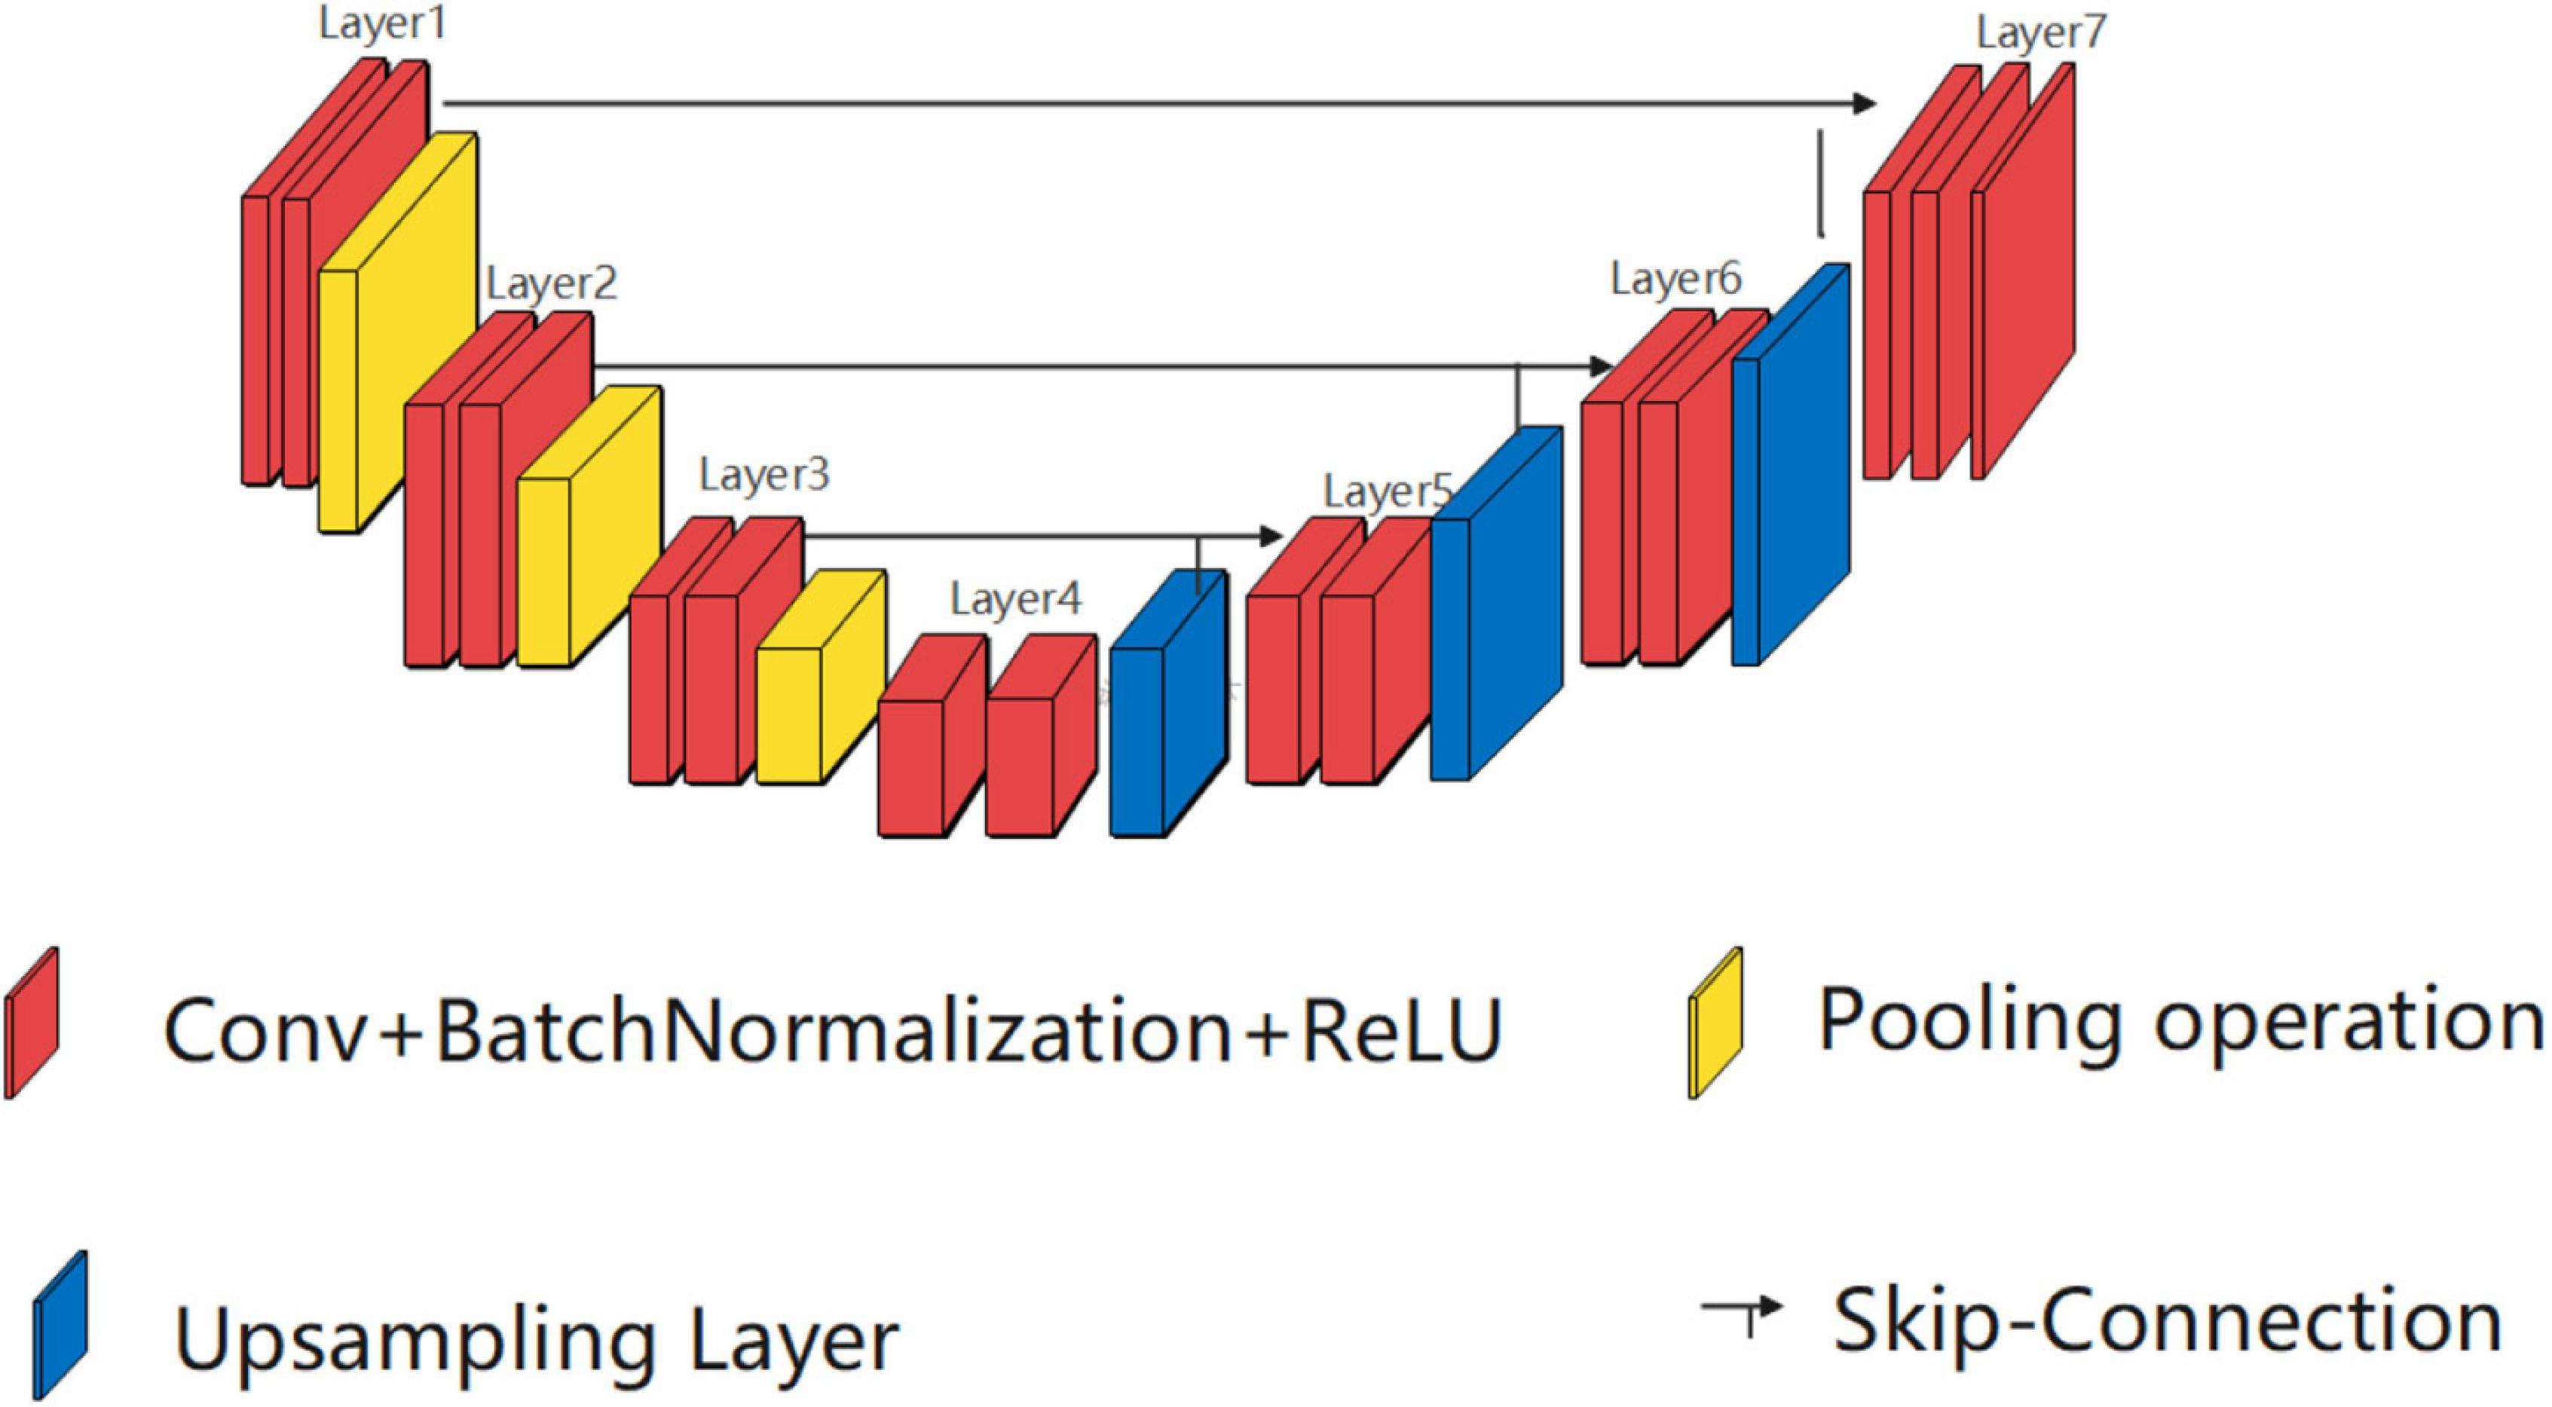
Recap: U-Net

Slide 5
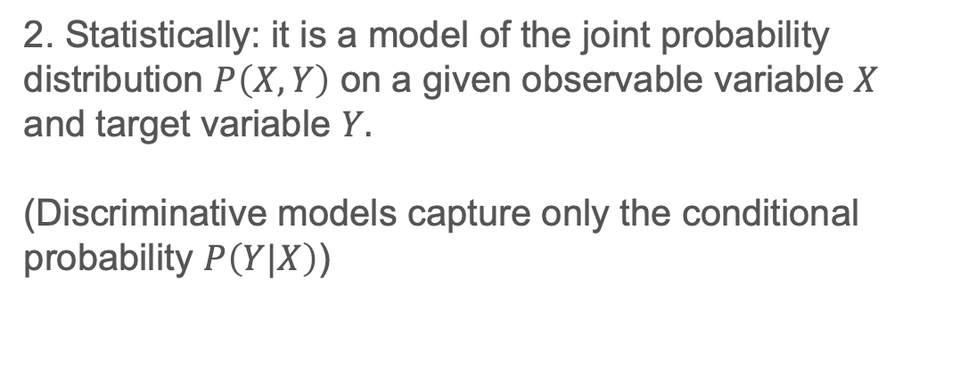
What is a generative model?
1. Generative modelling involves automatically discovering and learning the regularities or patterns in input data in such a way that the model can be used to generate or output new examples that plausibly could have been drawn from the original dataset.
2. Statistically: it is a model of the joint probability distribution $P\left(X,Y\right)$ on a given observable variable $X$ and target variable $Y.$
(Discriminative models capture only the conditional probability $P\left(Y|X\right)$)
Notes:
E.g. logistic regression is discriminative
Prob of label given the data

Slide 6
Why use generative models?

Slide 7
Motivation 1: better decision making

Slide 8
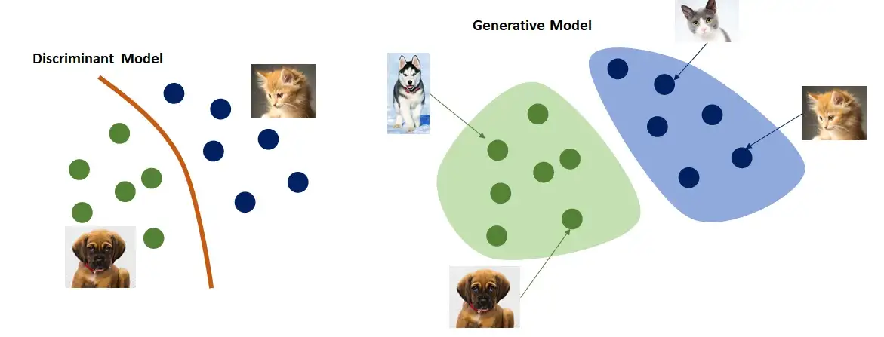

Slide 9
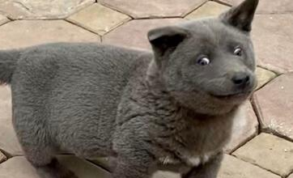

Slide 10
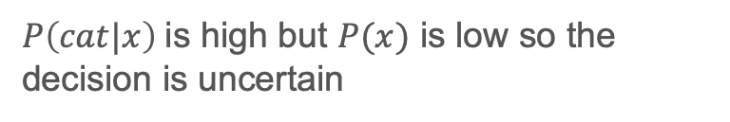
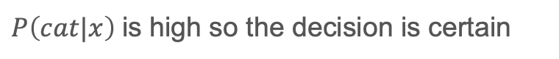
$$P\left(y|x\right)$$
$$P\left(y,x\right)=P\left(y|x\right)∗P(x)$$
$P\left(cat|x\right)$ is high so the decision is certain
$P\left(cat|x\right)$ is high but $P(x)$ is low so the decision is uncertain
Notes:
P(x) key, distribution of the data – also allows to generate or synthesize

Slide 11
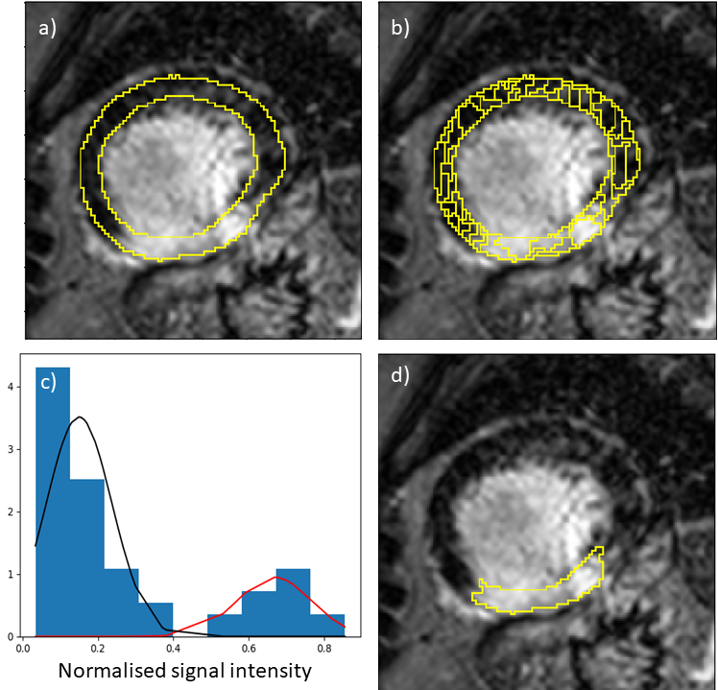
E.g. a Gaussian mixture model
Cardiac MR scar imaging
Intensity histogram
Scar segmentation

Slide 12
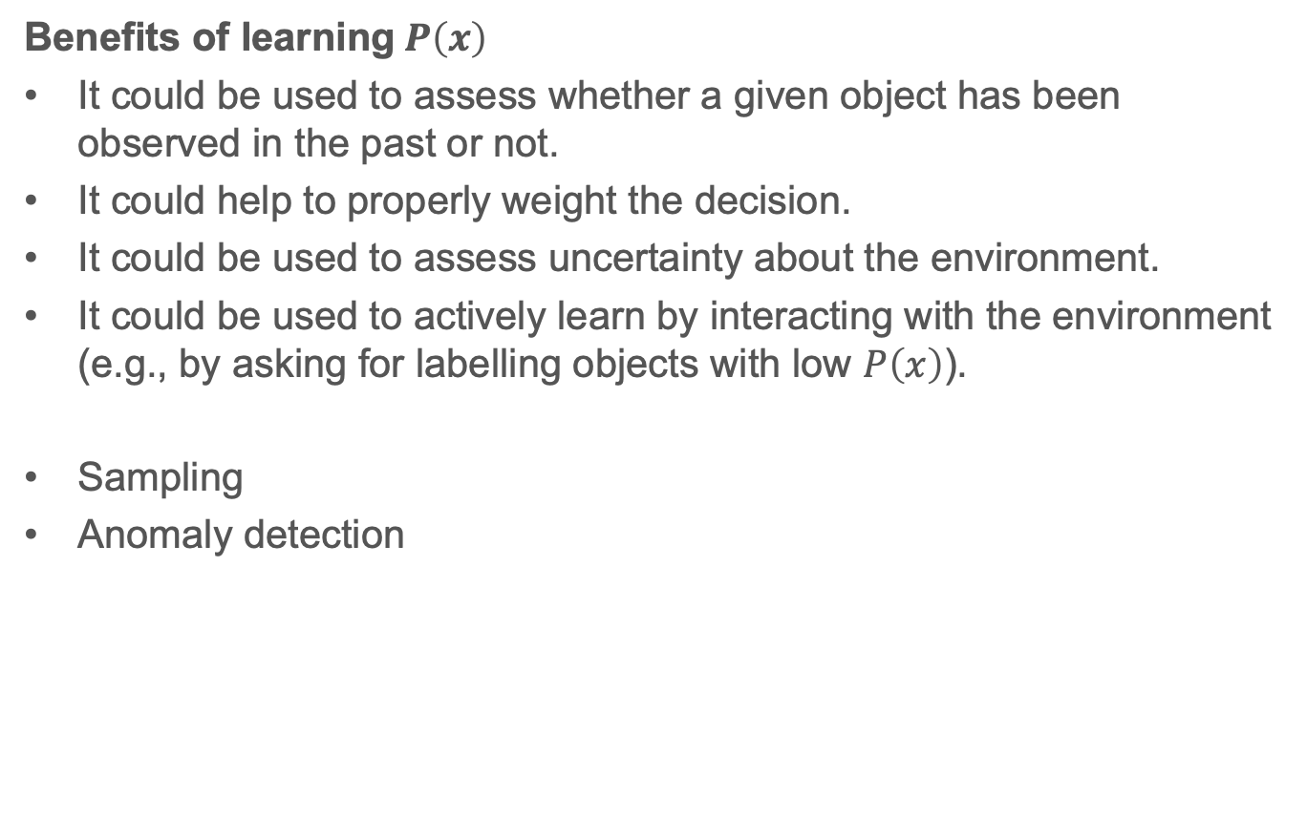
Benefits of learning$P\left(x\right)$
It could be used to assess whether a given object has been observed in the past or not.
It could help to properly weight the decision.
It could be used to assess uncertainty about the environment.
It could be used to actively learn by interacting with the environment (e.g., by asking for labelling objects with low $P\left(x\right)$).
Sampling
Anomaly detection

Slide 13
Motivation 2: generating data
If you have learned the data distribution then you can sample from this distribution.
If you know what the data looks like then you can generate a new point.

Slide 14
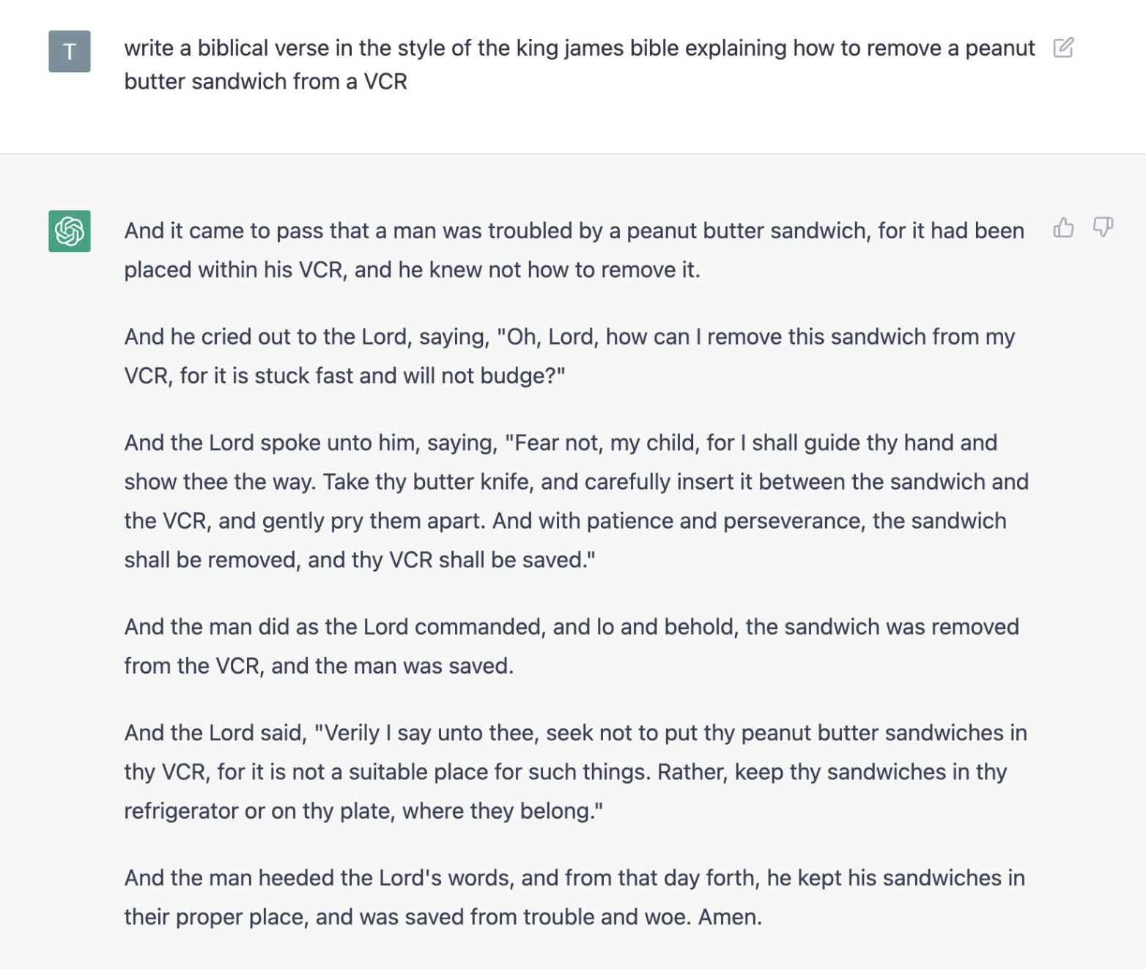

Slide 15
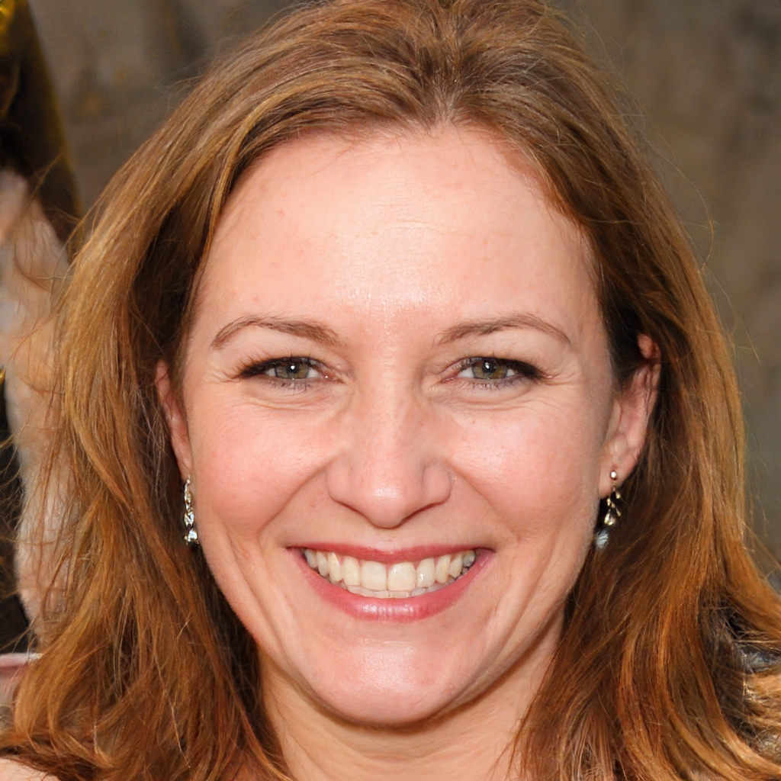
$https://thispersondoesnotexist.com/$

Slide 16
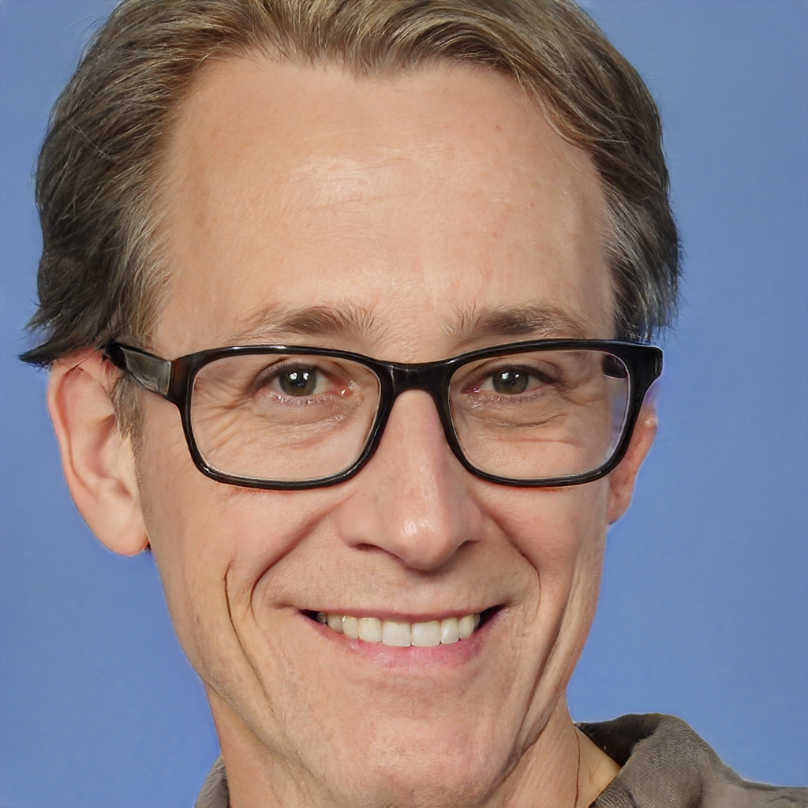

Slide 17
Benefits of synthetic data (important for medical image analysis)
It could increase the amount of available data.
It could be used to modify the features of available data.
It could be used to fill in missing points in the dataset.
It could add uncertainty quantification and explainability to analysis.
Project aim to use synthetic data to supplement the training of a segmentation model

Slide 18
Do we already know any generative models?
Almost
PCA is not a generative model but it is an example of a latent variable model – a key idea for use going-forward
It can reconstruct approximations to datapoints from the lower dimensional latent space but does not generate new independent samples

Slide 19
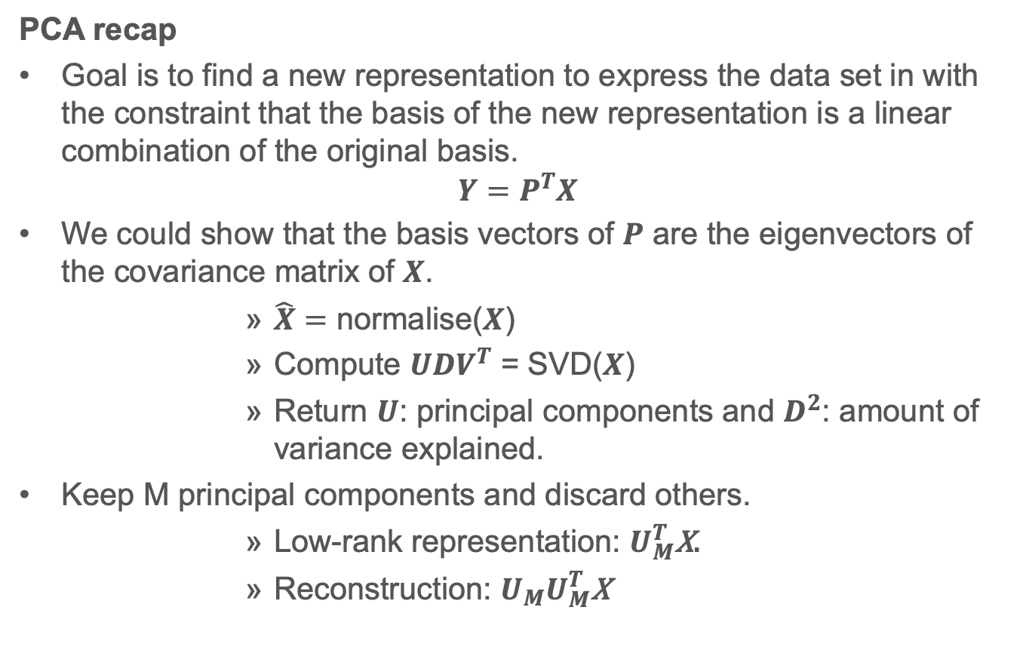
PCA recap
Goal is to find a new representation to express the data set in with the constraint that the basis of the new representation is a linear combination of the original basis.
$$Y=P^{T}X$$
We could show that the basis vectors of $P$ are the eigenvectors of the covariance matrix of $X$.
$\hat{X}=$ normalise($X$)
Compute $UDV^{T}$ = SVD($X$)
Return $U$: principal components and $D^{2}$: amount of variance explained.
Keep M principal components and discard others.
Low-rank representation: $U_{M}^{T}\text{X}\text{.}$
Reconstruction: ${U_{M}U}_{M}^{T}\text{X}$

Slide 20
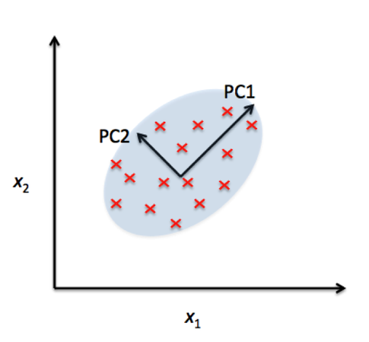

Slide 21
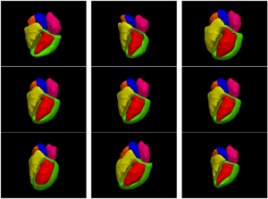
PC1
PC2
Mean shape + PC
Mean shape
Mean shape - PC

Slide 22
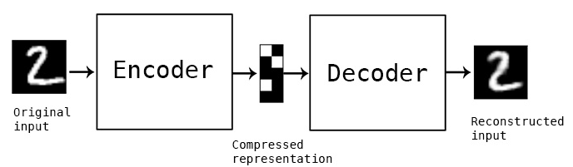

PCA
$$U_{M}^{T}$$
$$U_{M}$$
Latent variable: $\text{z}$

Slide 23
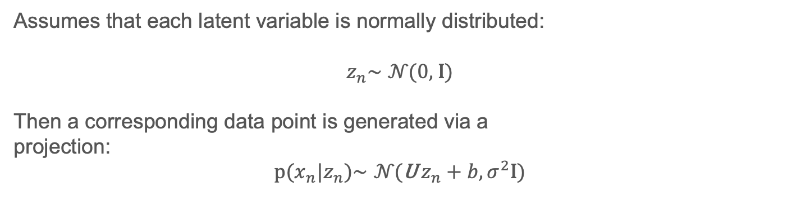
Probabilistic PCA
Assumes that each latent variable is normally distributed:
$$z_{n}\text{∼} 𝒩\text{(0, }\text{I}\text{)}$$
Then a corresponding data point is generated via a
projection: $$p({x_{n}|z}_{n})\text{∼} 𝒩\text{(}\text{U}{ z}_{n}+b,σ^{2}\text{I}\text{)}$$

Slide 24
Deep Generative models

Slide 25
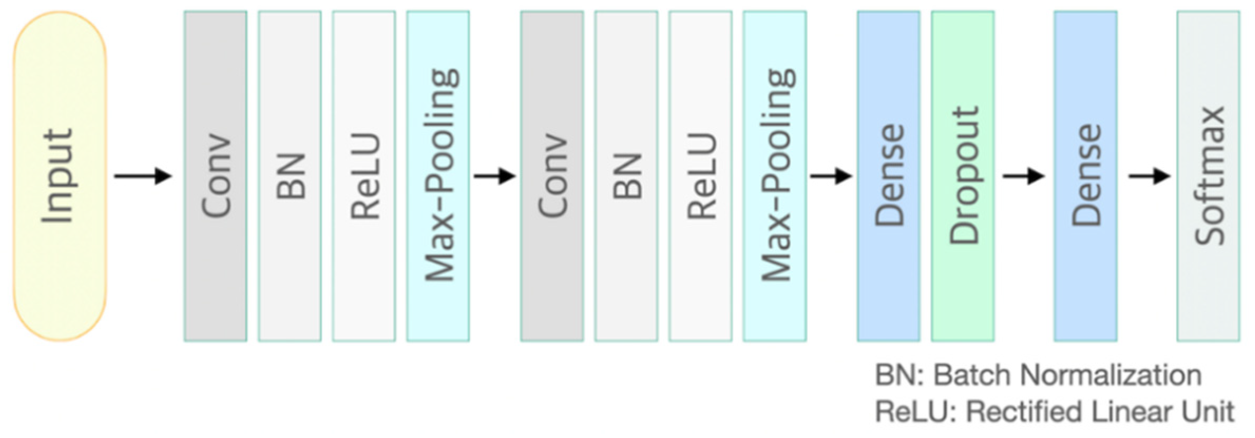
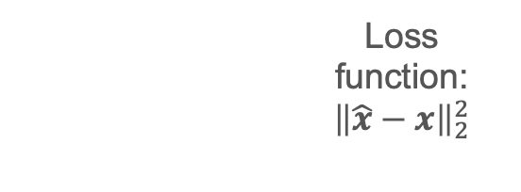

Autoencoder (non-linear extension of PCA)
$$f_{θ}:x↦z$$
$$g_{θ} :z↦\hat{x}$$
Loss function:
${\left\|\hat{x}−x\right\|}_{2}^{2}$
Latent variable: $\text{z}$
Convolutional block:
Notes:
Thought of like nonlinear PCA

Slide 26
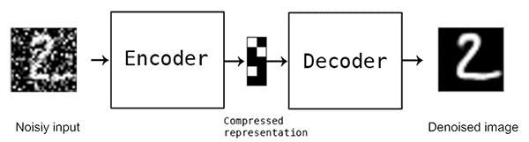
Denoising Autoencoder
$$f_{θ}:x+ε↦z$$
$$g_{θ} :z↦\hat{x}$$
Loss function:
${\left\|\hat{x}−x\right\|}_{2}^{2}$
Latent variable: $\text{z}$
Notes:
Thought of like nonlinear PCA

Slide 27
Applications:
Representation learning
Anomaly detection
Normative learning

Slide 28
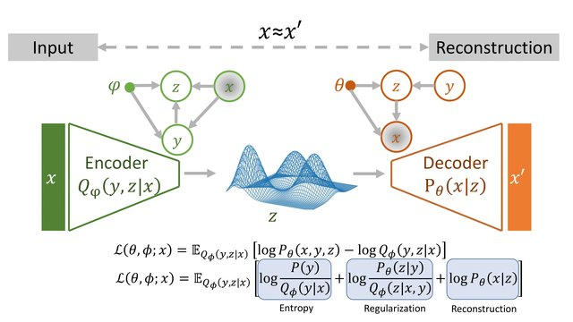

Variational Autoencoder - VAE
$$f_{θ}:x↦z$$
$$g_{θ} :z↦\hat{x}$$
Latent variable: $\text{z}$
The loss is a combination of a difference between the distribution on $\text{z}$ and an assumed prior distribution and a reconstrunction loss ($l1$ or $l2).$
Notes:
Thought of like nonlinear PCA

Slide 29
Variational Autoencoder - VAE
$$g_{θ} :z↦\hat{x}$$
Latent variable: $\text{z}$
Notes:
Thought of like nonlinear PCA

Slide 30
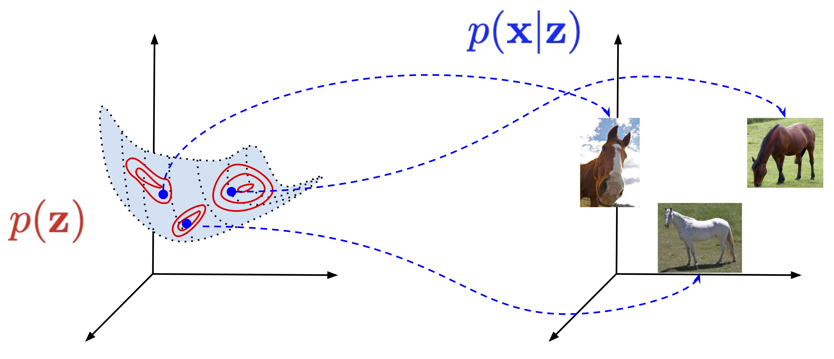
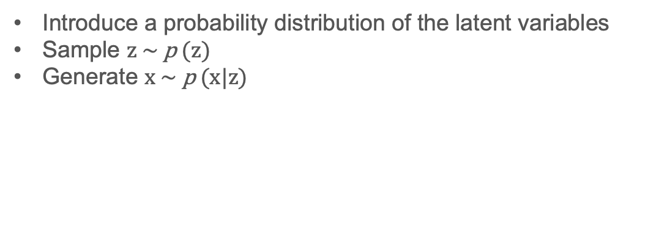
Generative latent variable models
Introduce a probability distribution of the latent variables
Sample $z \text{∼} \text{p}\text{ (}\text{z}\text{) }$
Generate $x \text{∼} \text{p}\text{ (}\text{x}\text{|}\text{z}\text{) }$
Generative process

Slide 31
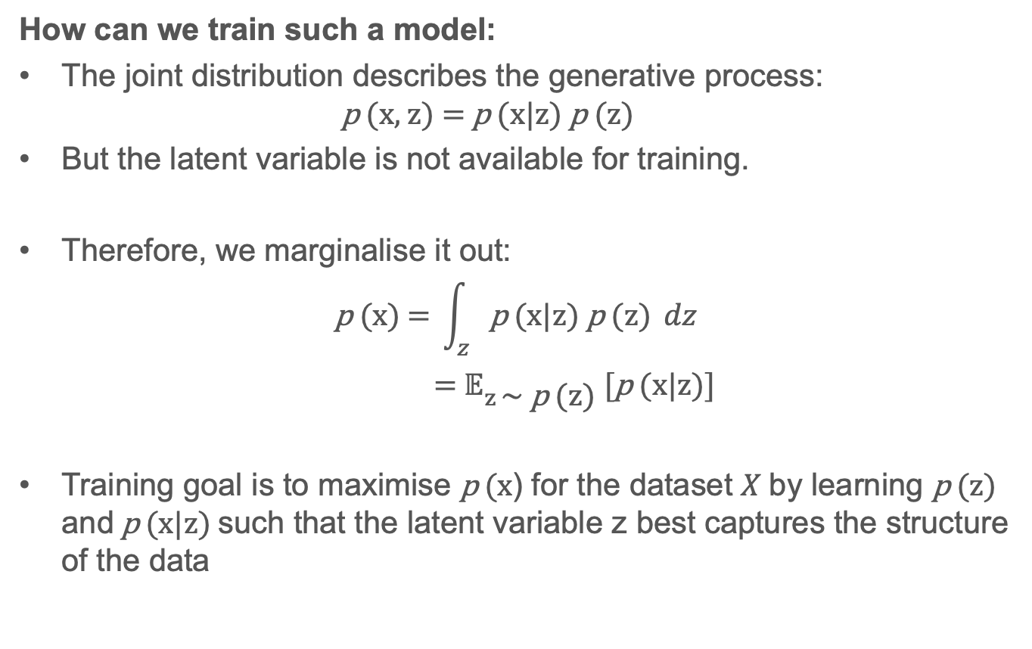
How can we train such a model:
The joint distribution describes the generative process:
$$\text{p}\text{ (}\text{x}\text{, }\text{z}\text{)} \text{=} \text{p}\text{ (}\text{x}\text{|}\text{z}\text{) }\text{p}\text{ (}\text{z}\text{) }$$
But the latent variable is not available for training.
Therefore, we marginalise it out:
$$\text{p}\text{ (}\text{x}\text{)} \text{=} \int_{z}{\text{p}\text{ (}\text{x}\text{|}\text{z}\text{) }\text{p}\text{ (}\text{z}\text{)}} dz$$
$\text{=} 𝔼_{z \text{∼} \text{p}\text{ (}\text{z}\text{)}} [\text{p}\text{ (}\text{x}\text{|}\text{z}\text{)}]$
Training goal is to maximise $\text{p}\text{ (}\text{x}\text{)}$ for the dataset $X$ by learning $\text{p}\text{ (}\text{z}\text{)}$ and $\text{p}\text{ (}\text{x}\text{|}\text{z}\text{)}$ such that the latent variable $\text{z}$ best captures the structure of the data

Slide 32
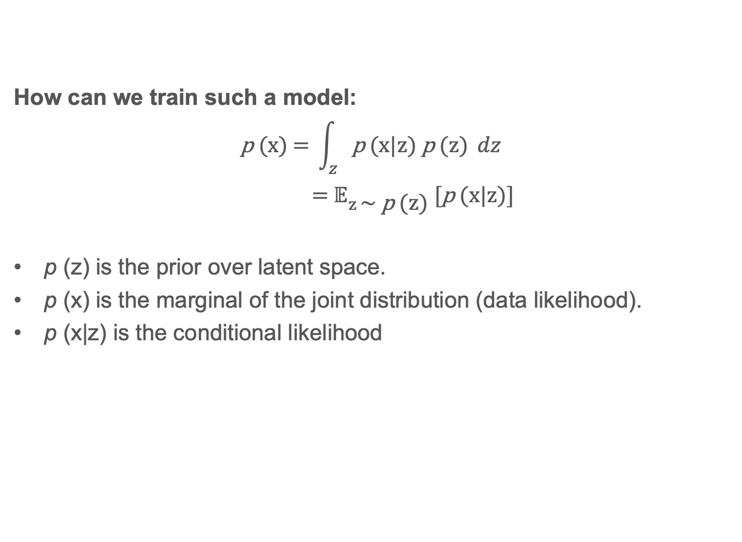
How can we train such a model:
$$\text{p}\text{ (}\text{x}\text{)} \text{=} \int_{z}{\text{p}\text{ (}\text{x}\text{|}\text{z}\text{) }\text{p}\text{ (}\text{z}\text{)}} dz$$
$\text{=} 𝔼_{z \text{∼} \text{p}\text{ (}\text{z}\text{)}} [\text{p}\text{ (}\text{x}\text{|}\text{z}\text{)}]$
$\text{p}\text{ (}\text{z}\text{)}$ is the prior over latent space.
$\text{p}\text{ (}\text{x}\text{)}$ is the marginal of the joint distribution (data likelihood).
$\text{p}\text{ (}\text{x}\text{|}\text{z}\text{)}$ is the conditional likelihood

Slide 33
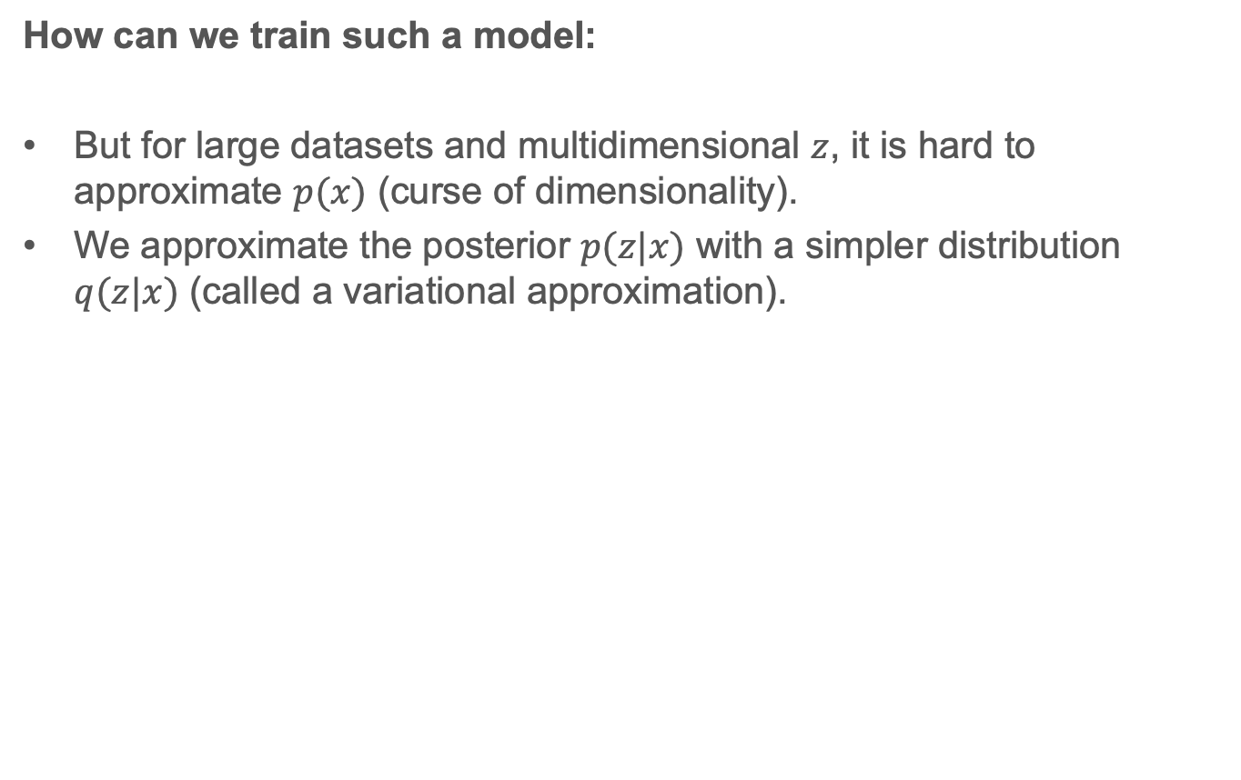
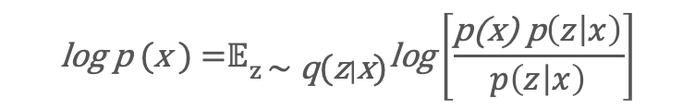
How can we train such a model:
But for large datasets and multidimensional $z$, it is hard to approximate $p(x)$ (curse of dimensionality).
We approximate the posterior $p(z|x)$ with a simpler distribution $q(z|x)$ (called a variational approximation).
$$\text{log} \text{p}\text{ (}\text{x}\text{ )} \text{=}𝔼_{z \text{∼} \text{q}\text{(}\text{z}|\text{x}\text{)}}\text{lo}\text{g}\left[\frac{\text{p}\text{(}\text{x}\text{) }\text{p}\left(z | x\right)}{p\left(z | x\right)}\right]$$
$\text{=}𝔼_{z \text{∼} \text{q}\text{(}\text{z}|\text{x}\text{)}}\text{lo}\text{g}\left[\frac{\text{p}(x,z)}{q\left(z | x\right)}\right]$ + $\text{log}\left[\frac{\text{q}\left(z | x\right)}{p\left(z | x\right)}\right]$
$\text{=}𝔼_{z \text{∼} \text{q}\text{(}\text{z}|\text{x}\text{)}}\text{lo}\text{g}\left[\frac{\text{p}(x,z)}{q\left(z | x\right)}\right]$ + $KL(q\left(z | x\right), p\left(z | x\right))$
$≥𝔼_{z \text{∼} \text{q}\text{(}\text{z}|\text{x}\text{)}}\text{lo}\text{g}\left[\frac{\text{p}(x,z)}{q\left(z | x\right)}\right]$ (ELBO)

Slide 34
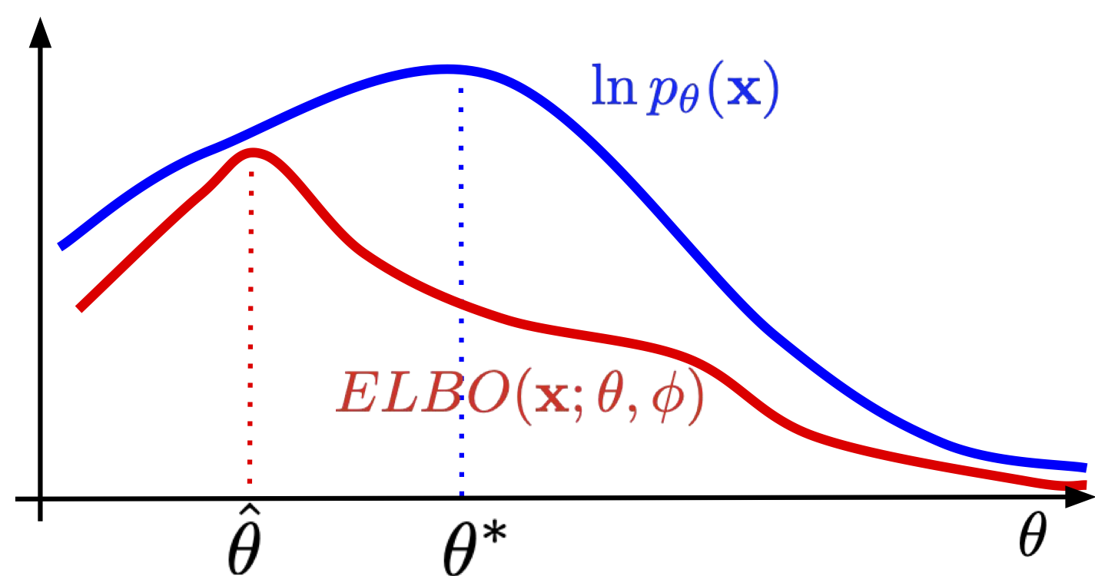

Slide 35

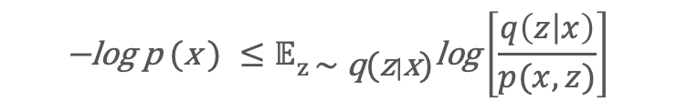

How can we train such a model:
Looks like an autoencoder: and
$$\text{−}\text{log} \text{p}\text{ (}\text{x}\text{ )} ≤𝔼_{z \text{∼} \text{q}\text{(}\text{z}|\text{x}\text{)}}\text{log}\left[\frac{q\left(z | x\right)}{p(x,z)}\right]$$
$${=𝔼}_{z \text{∼} \text{q}\text{(}\text{z}|\text{x}\text{)}}\text{log}\left[\frac{q\left(z | x\right)}{p\left(x | z\right)p(z)}\right]$$
$${=KL\left(q\left(z | x\right), p(z)\right)+𝔼}_{z \text{∼} \text{q}\text{(}\text{z}|\text{x}\text{)}}\text{− }\text{log}\left[p\left(x | z\right)\right]$$
$$q:x↦z$$
p$:z↦x$

Slide 36
Variational Autoencoder
$$q(z|x)$$
$$p(x|z)$$
Latent variable: $\text{z}$
Notes:
Thought of like nonlinear PCA

Slide 37
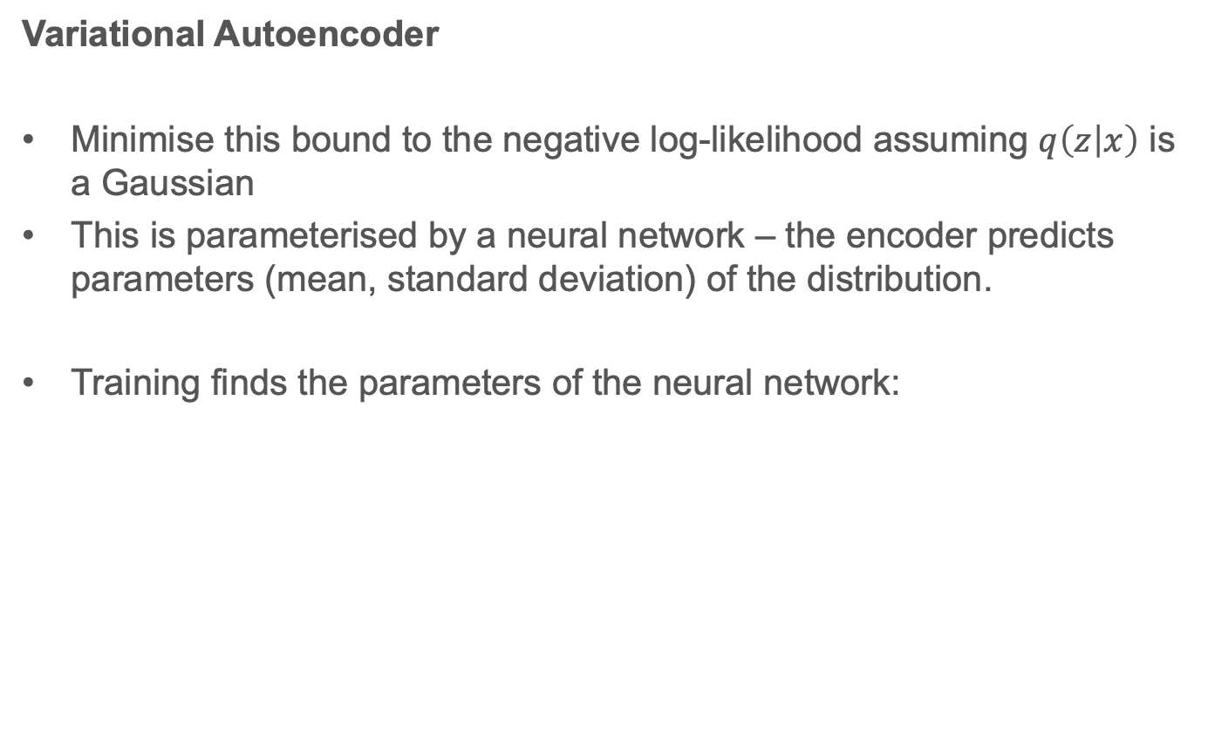
Variational Autoencoder
Minimise this bound to the negative log-likelihood assuming $q\left(z | x\right)$ is a Gaussian
This is parameterised by a neural network – the encoder predicts parameters (mean, standard deviation) of the distribution.
Training finds the parameters of the neural network:
$${θ^{∗}={argmin}_{θ} KL\left(q_{θ}\left(z | x\right), p(z)\right)+𝔼}_{z \text{∼}q_{θ}\text{(}\text{z}|\text{x}\text{)}}\text{− }\text{log}\left[p_{θ}\left(x | z\right)\right]$$

Slide 38
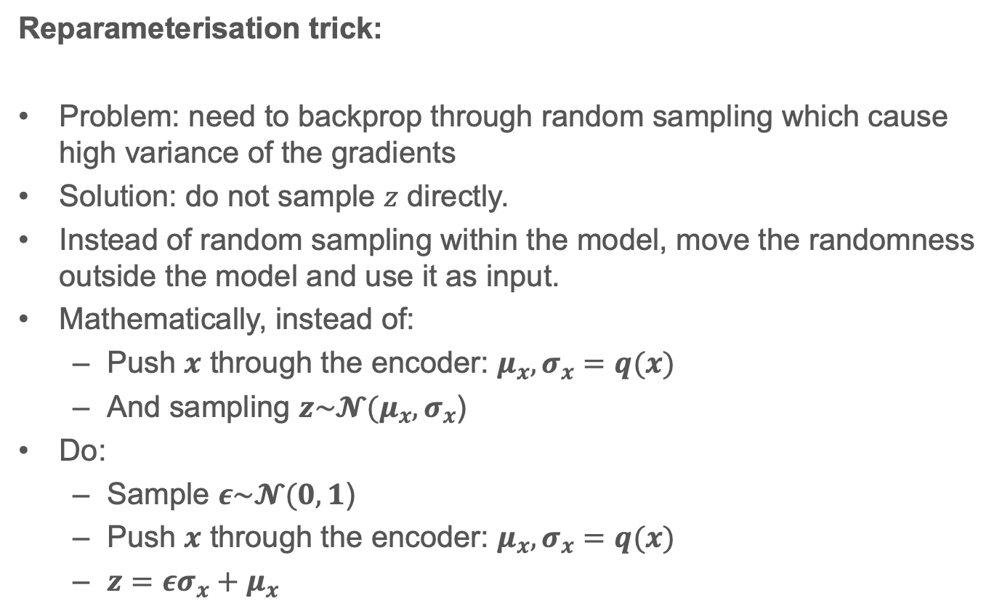
Reparameterisation trick:
Problem: need to backprop through random sampling which cause high variance of the gradients
Solution: do not sample $z$ directly.
Instead of random sampling within the model, move the randomness outside the model and use it as input.
Mathematically, instead of:
Push $x$ through the encoder: $μ_{x}, σ_{x}=q(x)$
And sampling $z\sim 𝓝(μ_{x}, σ_{x}$)
Do:
Sample $ε\sim 𝓝(0,1$)
Push $x$ through the encoder: $μ_{x}, σ_{x}=q(x)$
$z=εσ_{x}+μ_{x}$
Notes:
Thought of like nonlinear PCA

Slide 39
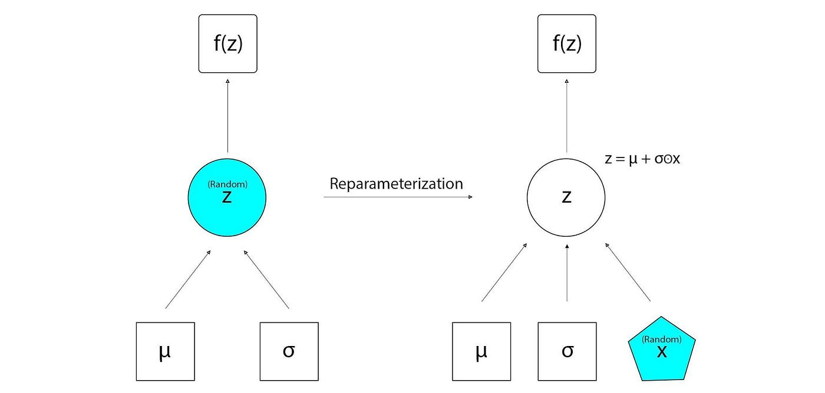
Reparameterisation trick:

Slide 40
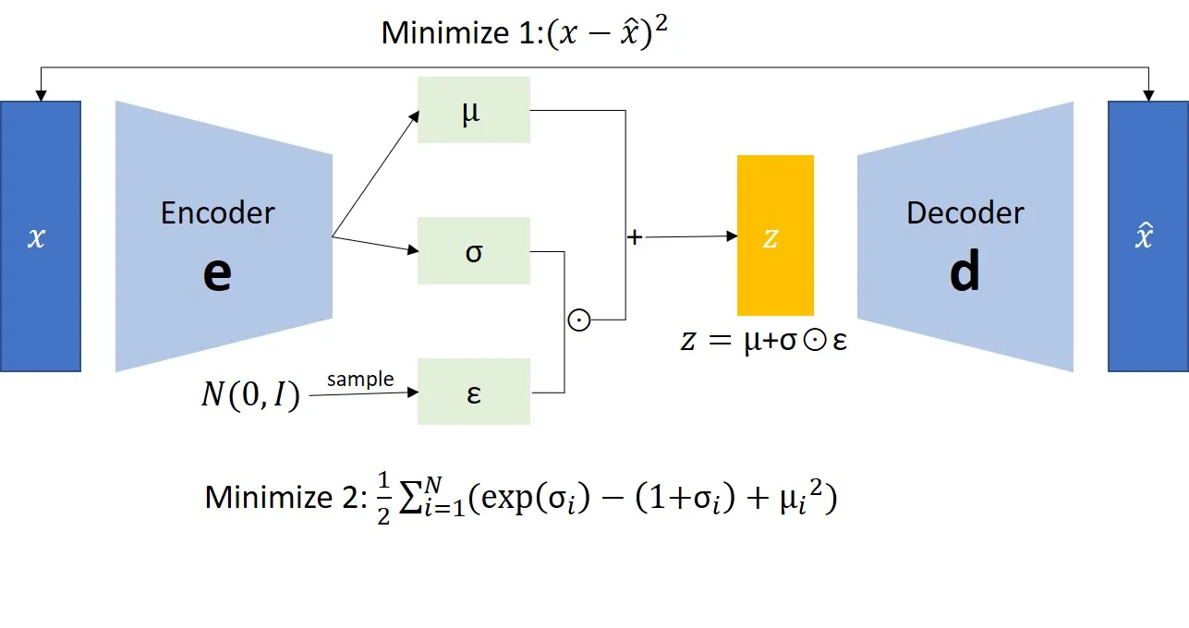
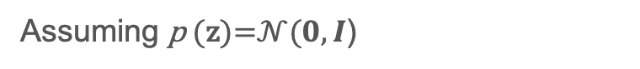
VAE – training procedure:
Assuming $\text{p}\text{ (}\text{z}\text{)=}𝒩(0,I$)

Slide 41
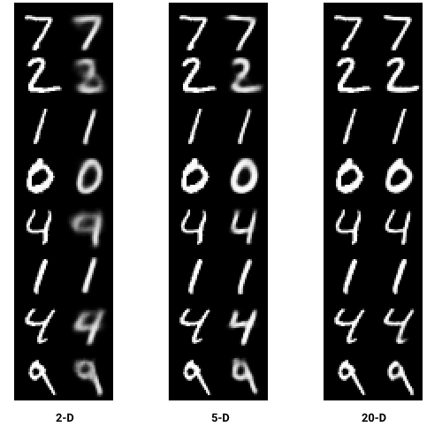
MNIST example:
Reconstructions:

Slide 42
Limitations:
VAEs may not generate samples that are as high-quality or as realistic as those generated by other models (next lecture), especially for images.
VAEs may struggle to generate samples from high-dimensional distributions or distributions with complex structures.
Classes may overlap in latent space. (Latent space is entangled).
Some points in latent space may generate samples that do not make sense (e.g. a combination of the shapes for two different numbers in the MNIST example)
VAEs can be sensitive to hyperparameter choice and may require careful tuning to achieve good results.

Slide 43
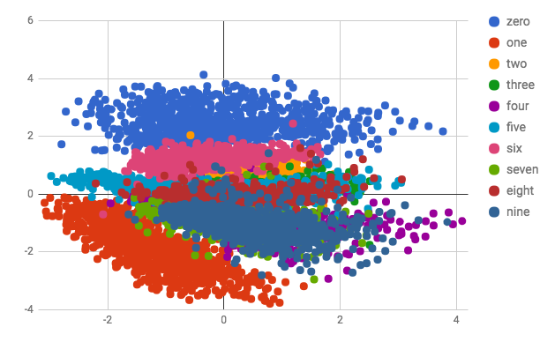
MNIST example:
Latent space:

Slide 44
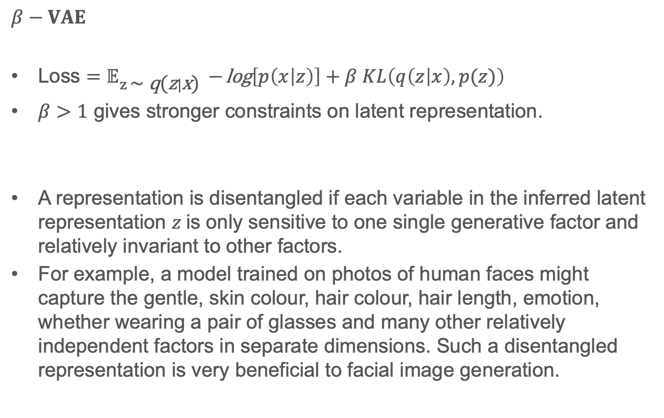
$$β−VAE$$
Loss ${=𝔼}_{z \text{∼} \text{q}\text{(}\text{z}|\text{x}\text{)}}\text{− }\text{log}\left[p\left(x | z\right)\right]+β KL\left(q\left(z | x\right), p(z)\right)$
$β>1$ gives stronger constraints on latent representation.
A representation is disentangled if each variable in the inferred latent representation $z$is only sensitive to one single generative factor and relatively invariant to other factors.
For example, a model trained on photos of human faces might capture the gentle, skin colour, hair colour, hair length, emotion, whether wearing a pair of glasses and many other relatively independent factors in separate dimensions. Such a disentangled representation is very beneficial to facial image generation.

Slide 45
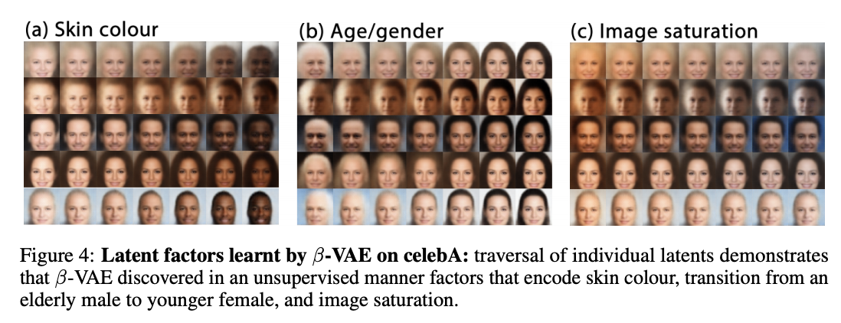
$$β−VAE$$

Slide 46
Discussion points
1. What is a latent variable model?

Slide 47
Discussion points
2. What will the latent variables be?

Slide 48
Discussion points
3. How do we enforce this?

Slide 49
Learning objectives
The student can:
Motivate the uses of generative machine learning models
Compare the benefits of generative and discriminative models
Understand the term latent variable model
Recall the PCA algorithm
Relate autoencoder models to PCA
Extend the idea of autoencoders to variational autoencoders
Describe the VAE loss function
Explain its derivation
Remember the reparameterization trick of VAEs
Identify the limitations of VAEs

Slide 50
Questions?

